Slide 1
Healthy Relationships
Amy Pinkston, LPN
Reproductive Health Program Manager
apinkston@midtownhealthne.org

Slide 2
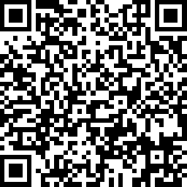
Pre-Survey Link
https://www.surveymonkey.com/r/YYM6ZDC

Slide 3
Everyone deserves quality health care!
Our goal is to make health care accessible to people, regardless of insurance status.
Private Insurance
Medicaid/Medicare
No Insurance
Underinsured/Major Medical plan
Service charges based on income
Notes:
Whether you have good insurance, bad insurance or no insurance at all. We have something to help you. Being an FQHC clinic gives us the opportunity to offer you a sliding fee. With the sliding fee it is based on your income and household size.

Slide 4
Medical
Comprehensive adult and
pediatric care
Dental
Cleaning, extractions, dentures, and other procedures
Behavioral
Outpatient therapy, medication management
Notes:
We offer medical dental and behavioral services.

Slide 5
Reproductive Health Services and Family Planning Priorities
Breast/Cervical Cancer Screening
STI Testing/Treatment
Contraceptives
Pregnancy Testing
Infertility Services
Prenatal Care
Services for minors
All Reproductive Health Services Are Confidential
Notes:
Amongst those services we specialize in reproductive health services. These services include ……..

Slide 6
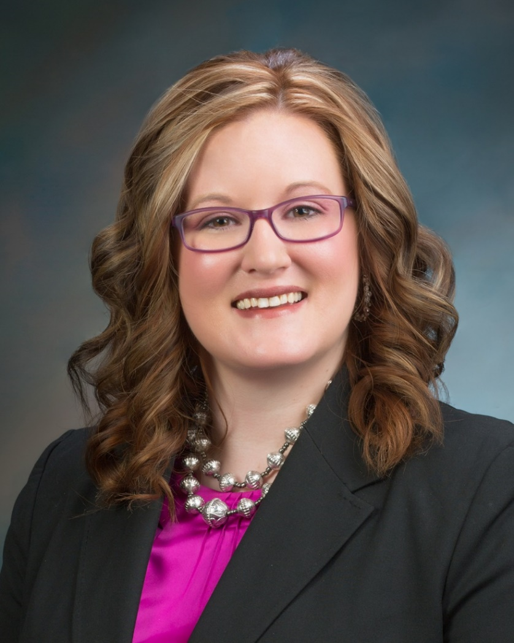
Mary Smith, APRN- NP
Kassidy Horst, APRN
Notes:
These are two of our current reproductive health providers. Mary mainly sees patients in our Norfolk location. And Kassidy sees patients in Norfolk on Mondays and otherwise in West Point. She does family practice as well now.

Slide 7
The things we will be discussing are personal. They can make people feel uncomfortable.
Ground Rules
Any question is OK
We all have different points of view
Listen respectfully
Right to Privacy
Notes:
Before we get started on the topic here are some ground rules…..

Slide 8
What is a Relationship?
The way in which two or more concepts, objects, or people are connected, or the state of being connected
Friends Parents Relatives Pets
Teachers Pastors Bosses Coworkers
Notes:
Ask : What is a relationship to you in your own words.
Give examples such as: PB & J or the earth and gravity

Slide 9
Forms of Effective Communication
Listens
Clarifies
Encourages empathically
Acknowledges
Restates/repeats
Relaxes
Opens up
Leans forward
Establishes eye contact
Shows appropriate facial expressions
Verbal
Nonverbal
Notes:
What about social media use? How do we form relationships

Slide 10
What Makes A Healthy Relationship?
Mutual respect
Trust
Honesty
Support
Fairness/equality
Separate identities
Good communication
A sense of playfulness/fondness
Work
Establishing boundaries together
Notes:
Ask: What makes a healthy relationship? To you what makes a relationship?

Slide 11
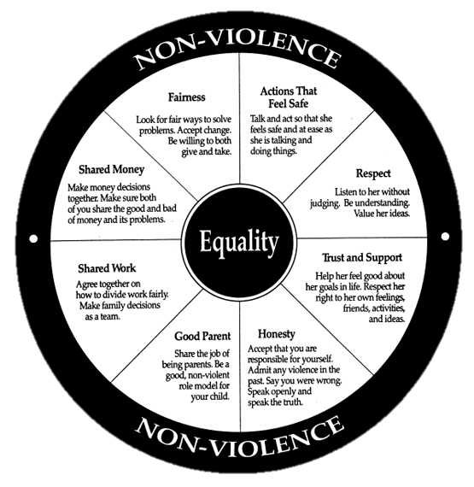
Notes:
This is our wheel of Equality.
Fairness: Take turns, tell the truth, play by the rules
Honesty: is someone telling their friend that the meal they prepared had too much salt. Or a student admitting they cheated on a test.

Slide 12
Signs of a Healthy Relationship
Takes care of oneself
Having good-self esteem
Maintain and respect each other’s individuality
Have activities apart from one another
Able to express yourselves to one another without fear of consequences
Feel secure and comfortable
Allow and encourage other relationships
Take interest in one another’s activities
Have the option of privacy
Respect sexual boundaries
Resolve conflict fairly
Notes:
What are some signs of a healthy relationship?

Slide 13
Good Communication
Uses “I” messages
Be honest
Appropriate body language
Clear/simple messages
Thinking then speaking
Listening
Waiting for your turn to speak
Mirror thought/feelings
Notes:
Never assume.

Slide 14
Boundaries
Some Examples Include
Emotional
Personal
Physical
“I love you”
Say it when you are ready
One partner might feel strongly enough to say it before the other
Time apart
Spend time with friends and family without permission
Being able to say when you want to do something on your own
Right to privacy
Money
Sharing bank accounts?
Loaning money
Take your time
Respect consent
A relationship doesn’t need sexual activity to be a good relationship
Sex isn’t currency
Holding hands in public
Notes:
Everyone has their own boundaries. Boundaries are like lines that cannot be crossed. Respect each others boundaries whether its an emotional boundary, a personal boundary, a physical one or digital one. It may even be more than one or even one that fits all. No matter what each others boundaries should always be respected.

Slide 15
Digital Boundaries
Ask Yourself
Is it okay to tag or check in?
Do we post our relationship status?
Is it okay to friend or follow my friends?
When is it okay to text me and what is the expectation for when we return it?
Is it okay to use each other’s devices?
Is it okay to post, tweet or comment about our relationship?
Digital dating agreements can be changed anytime throughout a relationship
Passwords should be private
Entitled to your own digital privacy
Not a requirement in a relationship
Photos and Sexting
Lose control of who sees it
Can say no
Boundaries are all about respect
Notes:
What do you think your relationship should look like online?
Why do we want to keep our passwords private?
-may post something without your permission
-might cause jealousy if seeing who you talk to
-purchase something without consent
-Access a bank account information
What are sites that you could give permission to use your password?
Passwords are private
Creates the idea of being able to spend time by yourself
Entitled to your own digital privacy
Not a requirement in a relationship
-if you want to share password then that is okay to but know your rights could be taken
-if you break up and passwords were shared…. Change your password immediately!
Photos and Sexting
Once its sent, that picture is no longer yours
Can lose control who sees it
Should be able to say no to sexting

Slide 16
Personal Rights in a Relationship You have a right to:
Be safe.
Say “no” without feeling guilty or selfish
Express feelings, including anger, without violating the rights of others
Be competitive, and to achieve.
Have your needs be as important as the needs of your partner.
Decide which activities will fulfill your needs.
Make mistakes, and be responsible for them.
Have your opinions given the same respect and consideration as others.
Change your mind.
Be independent.
Be treated respectfully.
Be cooperative and giving without being taken advantage of.

Slide 17
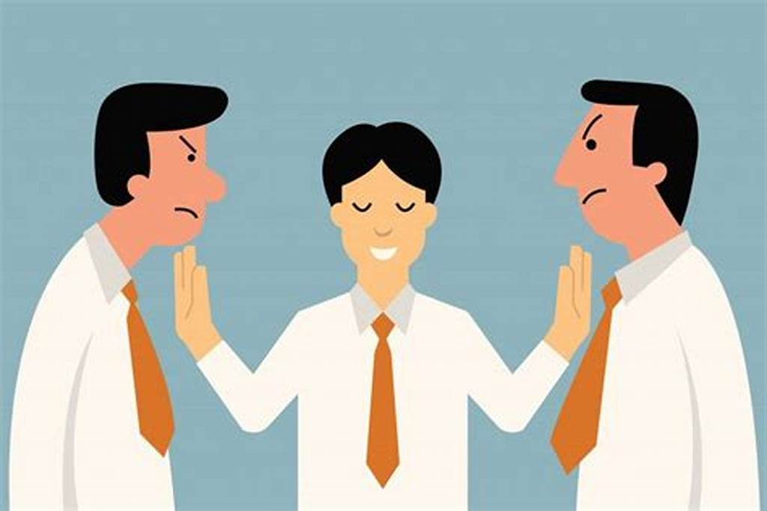
Conflict Resolution
Steps in resolving:
Define the problem clearly, from both points of view.
State what you agree on.
Brainstorm possible solutions.
What changes are each of you willing to make to arrive at a solution?
Summarize the best solution for both of you.

Slide 18
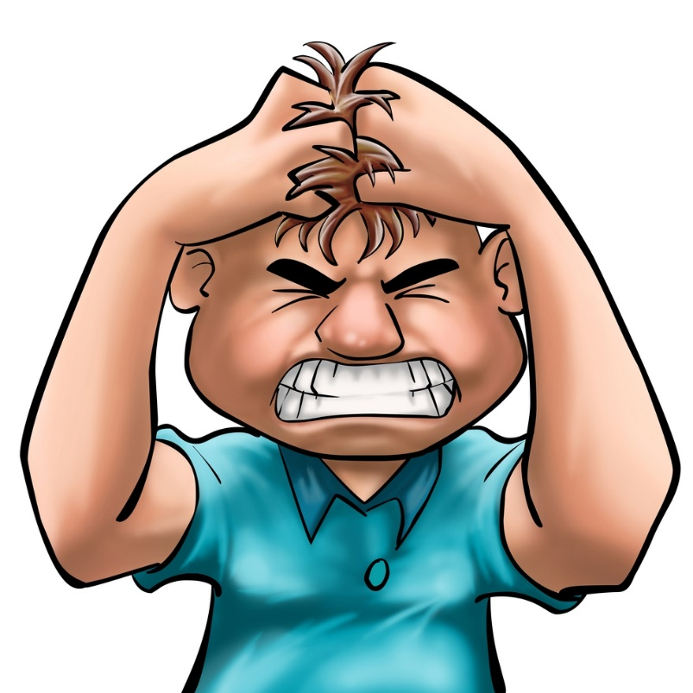
Communicating When You Are Angry
Stop
Take a step back and breathe
May want to take a short break before talking about the situation again
Think
Why did you get angry?
How to explain your feelings
Talk (by being honest, not attacking, finding the right time)
Listen
Hear their side

Slide 19
Unhealthy Relationships
Neglecting yourself or your partner
Feel pressure to change who you are for the other person
Feel pressure to quit activities you usually/used to enjoy
One of you is always justifying your actions
One partner feels obligated to have sex or is forced
Refuse to have safer sex methods
Arguments are not settled fairly
Unequal control of resources
Control or manipulate each other
Physical/emotional abuse
Have a lack of privacy
Notes:
What is your definition to an unhealthy relationship?
What makes a relationship unhealthy in your opinion?

Slide 20
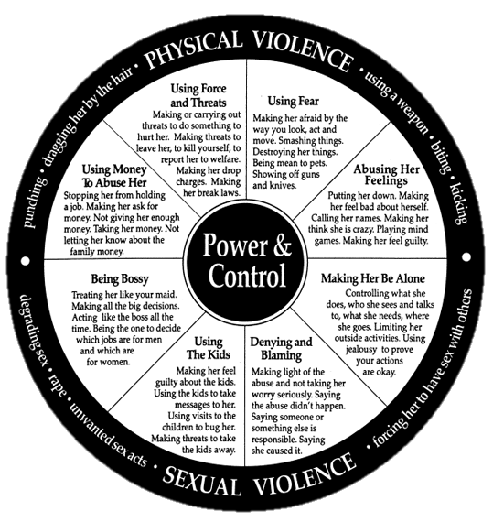
Notes:
This is our wheel of power and control
Give examples for each one…

Slide 22
Statistics
1 in 3 adolescents in the U.S. is a victim of physical, sexual, emotional or verbal abuse from a dating partner (National Council on Crime and Delinquency Focus)
43% of dating college women report experiencing violent and abusive dating behaviors (Knowledge Networks)
81% of parents believe teen dating violence is not an issue or don’t know if it’s an issue (Family Violence Prevention Fund and Advocated for Youth)
82% said they feel confident in recognizing the signs; 58% could not correctly identify all the warning signs of abuse
Every year, more than 3 million children witness domestic violence in their homes
Notes:
1 in 4 women and 1 in 7 men will experience domestic violence at some point in their life

Slide 23
Types of Abuse
Emotional/Psychological: Aim to lower your sense of self-worth
Verbal
Nonverbal
Physical: pushing, pulling, hitting, etc…
Sexual: anytime you feel forced into any sexual act you don’t want
Economic: keeps their partner financially dependent by controlling the money
Might not allow you to have a job or attend school
Digital
Notes:
Physical and sexual abuse can sometimes cross over
Important to remember that physical also deals with hitting, slapping, pulling, etc. not just sexual

Slide 24
Warning Signs of Dating Abuse
Checking your cell phone or email
Constantly putting you down
Extreme jealousy or insecurity
Explosive temper
Isolating you from family and friends
Making false accusations
Mood swings
Physically hurting you in any way
Possessiveness
Telling you what to do
Pressuring or forcing you to have sex
Notes:
Your cell phone is YOURS.
Constantly putting you down

Slide 25
Warning Signs- Victim
Sudden changes in appearance
Sudden changes in behavior
Avoids contact with family and friends
Depressed
Cries a lot; moody
Is very stressed, physical symptoms
Defends abuser and his/her actions
Spends all of free time with abuser

Slide 26
What is Consent?
What it looks like
Communicating every step of the way
Respecting when one says no
Understanding your own feelings
Open to ideas/suggestions
Giving a firm “yes”
What it DOESN’T look like
Assuming dressing sexy, flirting, accepting a ride is consent
Saying yes (or nothing) under the influence of drugs or alcohol
Giving in by feeling pressured or afraid to say no
Notes:
https://www.youtube.com/watch?v=raxPKklDF2k

Slide 27
Red Flags That Your Partner Doesn’t Respect Consent
Pressures or guilt you into doing things
Make you feel like you “owe” them
React negatively when you say “no”
Ignore your wishes
Does not read you nonverbal cues
Smooths talk you into something
Get consent every time

Slide 28
Consent can be given if a person is not…
Under the influence of alcohol
Under the influence of drugs
Mentally disabled

Slide 29
Coercion
Convincing someone to do something by using:
Force
Intimidation
Threats
Bribery
Guilt

Slide 30
Forms of Coercion
Emotional - Reacting with sadness, anger, or resentment
“I wouldn’t have taken you out to dinner if I had known you were leading me on.”
“I guess I’m just not attractive enough for you.”
Threats - Making someone feel afraid of what might happen if they say no
“If you don’t have sex with me, I’m going to break up with you.”
“If you don’t sleep with me, I’m going to tell everyone you are a prude / you did it anyway.”
Minimizing-
“It’s not a big deal, everyone is doing it.” “Other people’s boy/girlfriends…”
“You’ve done it before, this is no different.”
Harassment - Continuing to pressure someone after they say “no”
“ Just try it, I know you’ll like it.” “Come on, just one time.”
Guilt – Manipulating emotions
“If you didn’t want to sleep with me, you shouldn’t have been flirting with me.”
Notes:
Coercion: the practice of persuading someone to do something by using force or threats.

Slide 31
Sexual Assault- Felony
First Degree
Any type of penetration (oral, anal, vaginal) without consent of victim, or when victim is unable to give consent.
Victim: Ages <16 years of age
Perpetrator: Age 19+
Any touching, under or on top of clothing, with intent to sexually gratify victim or perpetrator.
Victim: <13 years of age
Perpetrator: Age 19+
Second (causes injury) and Third Degree (no injury)
Any touching, under or on top of clothing, with intent to sexually gratify victim or perpetrator.
Victim: <16 years of age
Perpetrator: Age 19+
Notes:
Sexual Assault of a Child
Class 1C Felony (if subsequent offenses): 20-50 years prison
Class 3A Felony: 1-5 years; $10,000 fine
1st degree
Class II Felony: Second offense- minimum sentence of 25 years without parole
3-50 years based on personal injury; 3 year mandatory minimum
2nd degree
1-20 years; $25,000 fine
3rd degree
Class III Felony: if offender caused serious personal injury to victim 1-20 years prison; $25,000
Class I Misdemeanor: up to one year; $1,000
Statutory Charge: can be applied to cases in which the victim is younger than age of consent even if the victim willingly engages in sexual relations with the defend

Slide 32
Feelings Someone May Experience When Leaving an Abusive Relationship
Love- they may believe they can change the abuser’s behavior
Fear- sometimes a partner will threaten to hurt themselves, or you, when you decide to break up
Doubt- it’s not always easy to admit that the relationship you are in is abusive. You may be worried about what people might think
Might be blindsided by “love”
Embarrassment- people who ask for help may feel like a failure
Notes:
Love- many abusers have a likeable and loving side that victims think about first
They may believe they can change the abuser’s behavior
Fear- sometimes a partner will threaten to hurt themselves, or you, when you decide to break up
Doubt- it’s not always easy to admit that the relationship you are in is abusive. You may be worried about what people might think
Might be blindsided by “love”
Embarrassment- people who ask for help may feel like a failure
Be there for them and remind them asking for help is a good thing

Slide 33
How Can You Help?
Don’t be afraid to reach out
Be supportive and listen patiently
Help recognize that abuse is not “normal”
Focus on the person who is being abused
Connect them to resources
Don’t contact their abuser or publicly post negative things about them online
Document any injuries
Give them the National Domestic Abuse Hotline number
1-800-799-7233

Slide 34
If You Are Being Abused
Understand that a person can only change if they want to
Focus on your own needs
Connect with you support systems
Make a safety plan
Be prepared for many emotions
Document any injuries
Call
Any abuse is not your fault!
National Domestic Abuse Hotline
1-800-799-7233
Notes:
Focus on your own needs
Taking care of yourself?
Do you feel constantly stressed out in a relationship?
Think about breaking up
Are you safe and accepted in your current relationship? Any abuse is not your fault!

Slide 35
Support Systems
Trusted friend, teacher, supervisor, family member, coach, faith leader, mentor, campus safety, or police
Identify someone you trust
“Am I ready to share?”
Bring up the topic
Could be difficult.. Find a creative way like watching a movie together
Set your boundaries
Be prepared for a strong reaction
Not everyone will understand

Slide 36
Safety Planning Tips When In An Abusive Relationship
Practice getting out of your home safely
Devise a code word or signal
Trust your instincts and judgement.
Leave money, extra keys, copies of important documents with someone you trust
Plan where you will go if you have to leave
Use a variety of routes home
Think about resources that can help with shelter/food/money
Notes:
Devise a code word or signal to use with your children, family, friends and trustworthy neighbors
You have the right to protect yourself (and your children) until out of danger
, extra medicine and clothes

Slide 37
Emotional Planning
Seek out supportive people
Identify and work towards achievable goals
Create a peaceful space for yourself
Physical space that helps you relax and understand your emotions
Remind yourself of your great value
Remember that you deserve to be kind to yourself

Slide 38
Summary
Relationship:
The way in which two or more concepts, objects, or people are connected, or the state of being connected
Communicate Effectively:
Listen
Restate
Be empathetic
Conflict Resolution:
Define the problem
Identify points of agreement
Know your limits with compromise

Slide 39
Any kind of abuse is NOT your fault.
You should be free from fear, guilt and shame.
You Should Always Be Safe.
Healthy relationships are important
National Domestic Abuse Hotline 1-800-799-7233

Slide 40
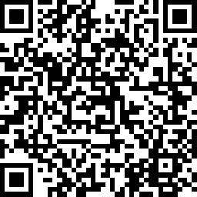
Post Survey
https://www.surveymonkey.com/r/YCHPL9V

Slide 41
Thank you! Questions?
Amy Pinkston LPN,
Health Programs Manager
apinkston@midtownhealthne.org

